Slide 1
DevOps: A Journey
By Michael Bueche
AVP IT Operational Excellence
USAA

Slide 2

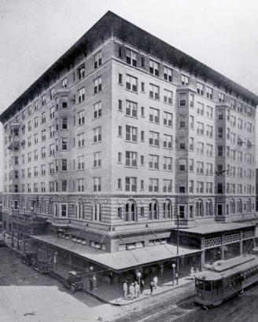
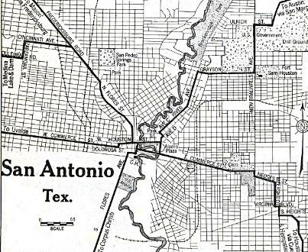
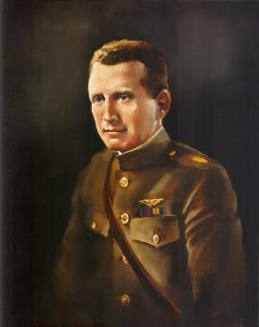
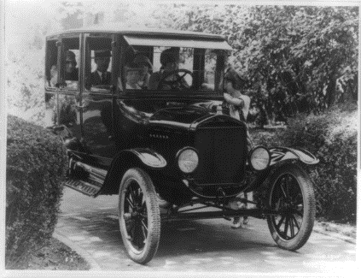

The Founding: Looking Out for One Another
Insuring each other when no one else would
Major William Garrison, Jr.
Notes:
USAA’s military roots go way back. USAA was founded in 1922 when 25 Army officers got together in San Antonio, Texas, at the Gunter Hotel.
They couldn’t find insurance companies to insure their automobiles, because their military lifestyles were considered too risky.
So they pooled their money and formed an association to insure one another when no one else would.
For more than 90 years and counting, USAA has remained an organization that strives to look out for the best interests of the membership.

Slide 3
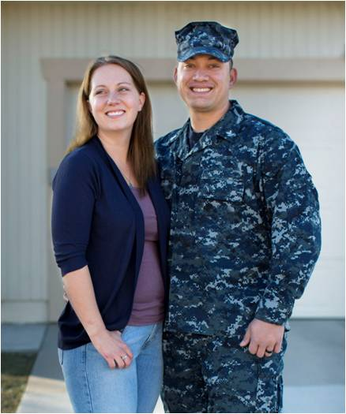
Facilitating Financial Security for Military Families
USAA Mission
The mission of the association is to facilitate the financial security of its members, associates, and their families through provision of a full range of highly competitive financial products and services; in so doing, USAA seeks to be the provider of choice for the military community.
Core Values
Service
Loyalty
Honesty
Integrity
Notes:
It’s not only what we do, but how we do it, that makes USAA different.
What sets USAA apart from other financial-services companies is our unique mission and the military values that drive USAA:
(Read mission)
The same military-inspired core values that our members live by – service, loyalty, honesty and integrity – also drive USAA and our employees.
_______________________________________________________________________
Photo: USAA 2014 Report to Members.

Slide 4
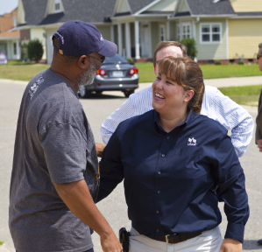
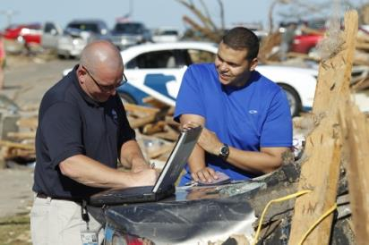
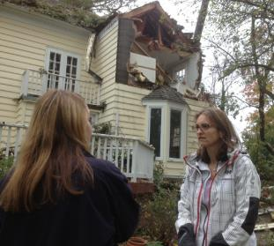
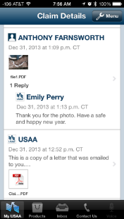
There When Our Members Need Us
On the scene of disasters in 2013 and fast to settle everyday claims
100K | 5M+ | 81%
disaster claims | auto and property claims | Claims satisfaction
Numbers at year end, 2013
Notes:
The true test of USAA service is being there when our members really need us.
USAA is often on the scene after natural disasters within hours, dispatching adjustors and using technologies like aerial surveillance to help some members file claims before they can even get back into their neighborhoods. In 2013, USAA handled 100,000 disaster claims, helping members restart and rebuild.
Of course, millions of members relied on USAA to help them fix fender benders and respond to home-damage claims and other everyday losses. Our new Claims Communications Center lets members go online to interact with claims agents and get timely updates.
______________________________________________________________________________
Photo on the left: Surviving the Storm, Reid Family, Fayetteville, NC with USAA P&C claims rep.
Photographer: Karl Neal Gerber
Photo second from the left: Homeowner, Eileen, MacDonald with USAA claims professional in Annapolis Maryland. USAA member home after Hurricane Sandy.
Photographer: USAA CAT team
Center image:
USAA App Screenshot provided by P&C
Image on the right:
USAA claims adjuster, Chad Turner with member, Michael J. Butler at the site of his home destroyed by tornado.
Photographer: Karl Neal Gerber

Slide 5
Financial Strength to Meet Our Commitments
USAA’s net worth — one of the best measures of our ability
to meet our commitments today and for years to come
Rating Agency¹
Aaa | Exceptional | Moody’s
A++ | Superior | A.M. Best
AA+ | Very strong | Standard & Poor’s
¹Ratings of USAA P&C Insurance Group
$24B
In Net Worth
Notes:
One of the secrets to USAA’s ongoing success is prudent, conservative financial management. We try to be good stewards of our members’ hard-earned assets.
There is no better proof of our management team’s prudent stewardship than the fact that USAA’s Property and Casualty Insurance Group remains one of only a few companies with the highest-possible financial strength ratings from Moody’s and A.M. Best.

Slide 6

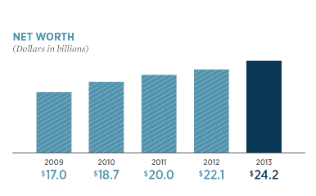

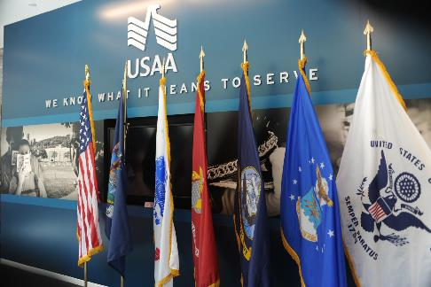
Sources of USAA’s Strength
We call it our secret sauce!
 | 10M+
 | Honorable members
25K+ |  | $24B+ net worth
of the world’s best employees |  | Because of our conservative financial management
Notes:
More than 90 years after 25 Army officers met to join together for a common purpose, the secret to USAA’s ongoing success remains:
the world’s best employees
the world’s most honorable members
and conservative financial management
________________________________________________________________________________
Two photos on the left: USAA employees (2013).
Center image:
USAA West Point Financial Center Grand Opening
Photographer: Susan Farley
Image on the right:
Bar chart graphic from the upcoming USAA 2013 Report to Members. Page 23 (as of 2/25/2014).

Slide 7
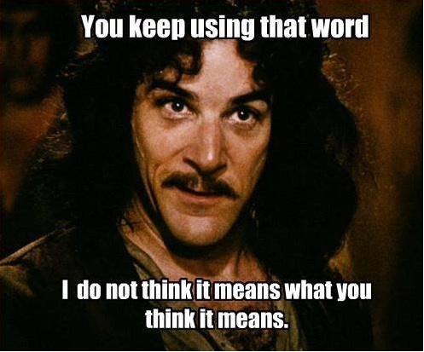
DevOps

Slide 8
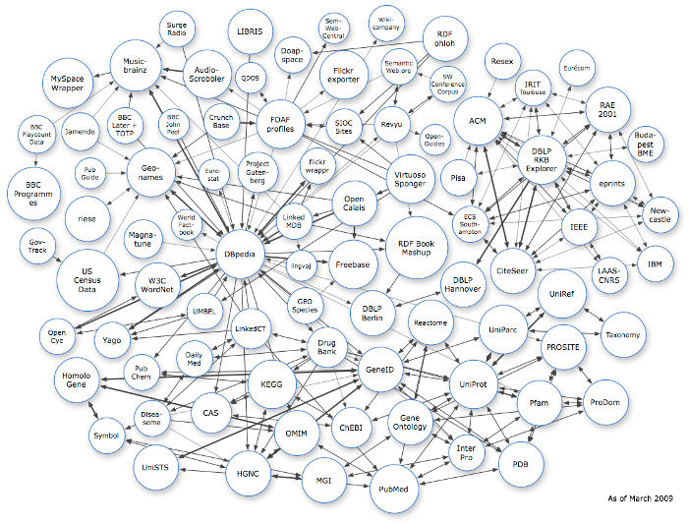
It’s Really Simple …

Slide 9
Why DevOps? Why Now?
2008: Average Time to Market – 158 Days
Requirements, Analysis, Design
Development
Testing & Release
Ideal State – Quick Iterations, Release When Ready
Requirements, Analysis, Design
Dev & Test
Release

Slide 10
Where We Started
LOBs
MBR
Bank
P&C
Invest
Life
MBR
Bank
P&C
IMCO
Life
Notes:
Optim
Start with Customer file
Move to products
Tie products together
UI or script interfaces
IMPORTANT BYPRODUCT: Developers AND business users are now using this tool to provision data for all kinds of uses (way beyond automated tests) – example: training data for call centers

Slide 11
What is DevOps? An Elevator Pitch
Need everyone on the same page
Needs to be anchored to something everyone can agree on.
Needs to be Aspirational
Needs to be internally branded
Notes:
There were many different perspectives on what exactly DevOps is … usually persuaded by their “myopic” lens of whatever department they worked in. Operations though in terms of servers, network, firewalls, etc. While development thought about releases, agile and testing cycles.

Slide 12
Break it down to something simple
Workstation
CIT Box
Runway
Prod QA
Production
28 Days
10K Defects Prevented
Current Release Process
7 Days
75% reduction in time to release
Target Release Process

Slide 13
Approached it in layers
Developer Driven Testing
Automated Build and Test (CI)
Run Automation EVERY DAY
Virtualization
Common Test Automation Framework
Test Data Management

Slide 14



Test Data Management
1
TDM Self-Service Tool
TDM API
Test Automation
LOB Specific APIs
MBR APIs
Bank APIs
P&C APIs
Invest APIs
Life APIs
MBR
Bank
P&C
IMCO
Life
Notes:
Optim
Start with Customer file
Move to products
Tie products together
UI or script interfaces
IMPORTANT BYPRODUCT: Developers AND business users are now using this tool to provision data for all kinds of uses (way beyond automated tests) – example: training data for call centers

Slide 15
Test Automation Framework
2
Common framework for multi-platform
Selenium
Mobile – Robotium and Perfecto

Slide 16
Service Virtualization
3
Major 3rd Party services
Services that are hard to test “live” like money movement, trades, etc.
Tied it to the SOA governance board for all new/modified services
Created Virtualization standards and frameworks for web/host

Slide 17
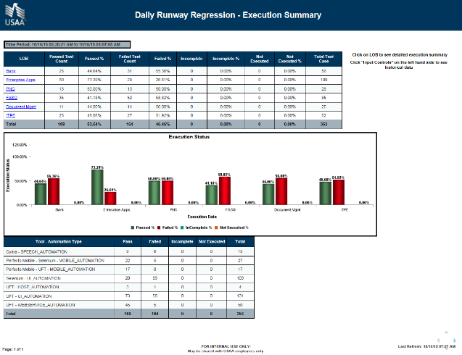
Daily Runway Regression
4
540 Regression Scripts across all LOBs
Looks at merge history, contacts all tech leads of teams that merged code that day.
Info notice for teams who previously merged into that release.

Slide 18
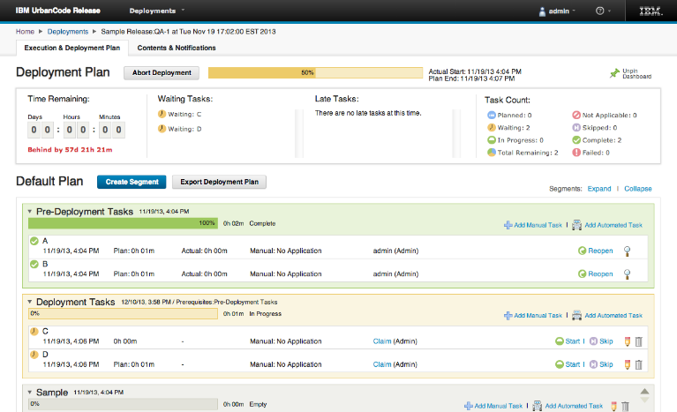
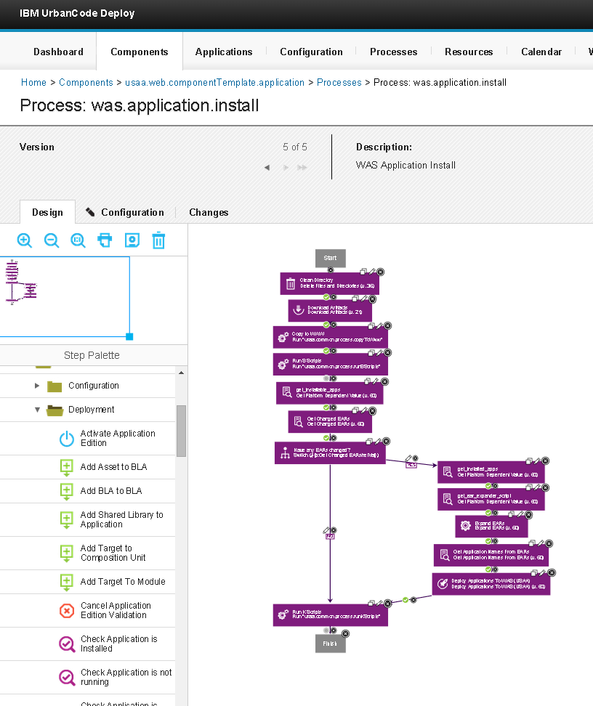
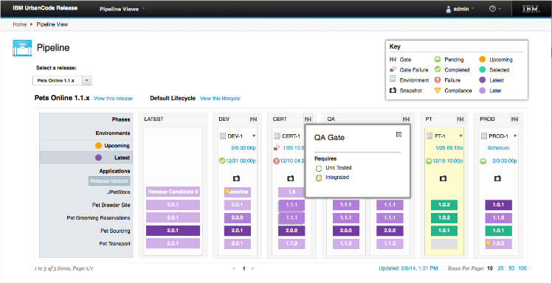
Tied to the Build
5
Collaborative, web based release planning and execution.
Insight into which projects in a release are on time.
Clear visibility into which versions of each application are in each environment.
Enforced quality gates governing advancement into environments.

Slide 19
Developer Driven Testing
6
Cultural
Fighting against “time to market”
Start with an adventurous team, share results
Leverage a “me too” culture
Look for volunteers
Stop saying “pushing to the left”
DDT as the norm, move from functional to unit

Slide 20
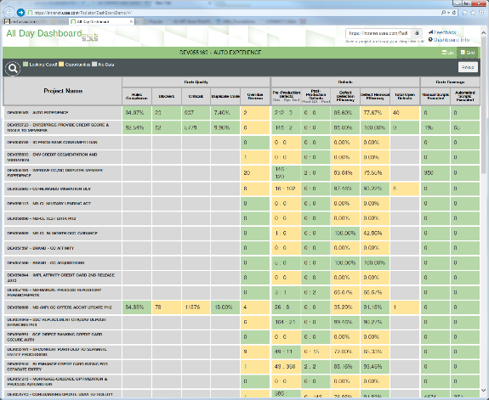
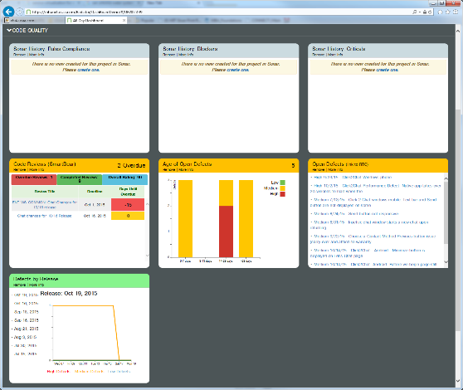
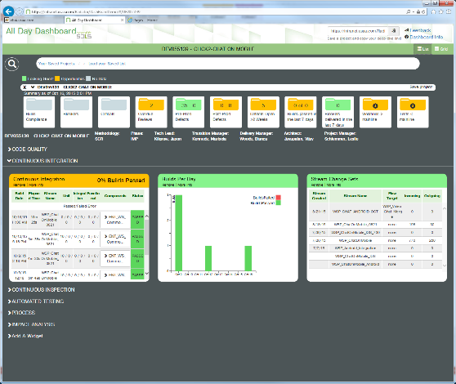
DDT-All Day Dashboard
6
Leverage Short Feedback Loops
How do you create an instantaneous feedback loop?
Leading indicators to quality as opposed to lagging
Risk based approach to releases

Slide 21
So … How’s it going?
3 weeks ago we released “Independent Release”
Allows Developers to release Web code to production in 9 days (down from 28 days)
Requires Automated builds and testing.
Hooked into the All Day Dashboard metrics

Slide 22
Top Five Takeaways
Keep it Simple
Approach it in small measurable steps
Don’t expect to change behavior if you haven’t given them the means to change.
Short Feedback loops help people learn/improve
Remember – Culture eats strategy for breakfast

Slide 23
DevOps: Our Journey Continues
By Dibbe Edwards
VP, DevOps for Hybrid
IBM

Slide 24
My Development Organization – a Global Team
Sweden
Russia
UK
Canada
Poland
China
France
Israel
Japan
United States
Switzerland
India
Taiwan
Mexico
Australia
Brazil
Challenges:
- >50 + products, components and micro services - Move from tightly coupled to cloud architecture
- Dispersed feature teams/squads - Innovation in the face of KLO needs
Transform business processes and engineering through changes in culture, process and technology at scale !
Notes:
24
D1_Sabbah
10/19/15 10:57
IBM Rational
24

Slide 25
Product and Process Improvements… our journey continues!
Lifecycle Measurements | 2008 | 2010 | 2012 – 1Q2015 | Total Improvement
Project Initiation | 30 days | 10 days | 2 days | 28 days
Groomed Backlog | 90 days | 45 days | On-going | 89 days
Overall Time To Development | 120 days | 55 days | 3 days | 117 days
Composite Build Time | 36 hours | 12 hours | 5 hours | 700 %
BVT Availability | N / A | 18 hours | < 1hour | 17 hours
Sprint Test Time | 5 days | 2 days | 14 hours | 4 days
Total Deployment Time | 2 days | 8 hours | 4 hours -> 20 minutes | 2 days
Overall Time To Production | 9 days | 3 days | 2 days | 7 days
Time Between Releases | 12 Months | 12 Months | 3 Months | 9 Months
Innovation / Maintenance | 58% / 42% | 64% / 36% | 78% / 22% | +20% / -20%
Double-digit revenue growth, increased client adoption, improved client satisfaction
Notes:
This highlights the focus that we have had in IBM on driving improvements across the entire lifecycle. These metrics has helped us to achieve improvements in collaboration between the business and dev/test/ops and also driven significant improvements in the efficiency of our organization and effectiveness of our products in the industry. Now as we are broadening the usage of these improvements we are now focusing on Scaling these practices to a larger set of services and teams so – click for the next page (in screen show mode)

Slide 26
Product and Process Improvements – at scale !!
Lifecycle Measurements | 2010 | 2012 – 2014 | 2Q-3Q 2015 | Total Improvement
Project Initiation | 10 days | 2 days | 8 hours | 9 days
Groomed Backlog | 45 days | On-going | On-going | 44 days
Overall Time To Development | 55 days | 3 days | 1 day | 54 days
Composite Build Frequency (per week) *sandbox/component builds ongoing | 3 builds | 5 builds | 10 builds | >200%
BVT Availability | 18 hours 1 / day | < 1hour 1 / day | < 1hour 4 / day | 17 hours 4x environments
Pipeline Deployments (per week) | 2 (manual) | 50 | 140 | 70 x
Build/BVT/Pipeline/Staging (% automated) | 0% | 50% | 100% | 100% automated testing
Sprint Test Time | 2 days | 14 hours | 6 hours | 42 hours
Total Deployment Time | 8 hours | 4 hours | 20 minutes | 4 x
Overall Time To Production | 3 days | 2 days | 2x daily | 6 x
Time Between Releases | 12 Months | 3 Months | Monthly* | 11 Months
Innovation / Maintenance | 64% / 36% | 78% / 22% | 83% / 17% | +19% / -19%
*deliveries to jazz.net
Double-digit revenue growth, increased client adoption, improved client satisfaction
Notes:
DRAFT The numbers on this slide are still being finalized with the team. Scaling so in addition to time we have added volume to our way of driving the next wave of improvements. We need to support multiple teams building services and capaiblities in parallel so scale (of our pipeline, automated testing, build) has become an essential mesure for our future success. This year we are not focused on not only our quarterly deliverables by daily to our own ‘selfhost enviroment and monthly to our clients via our jazz.net community.

Slide 27

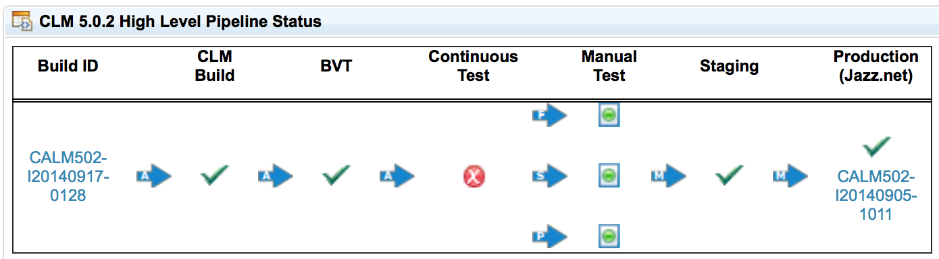

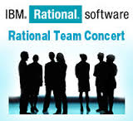
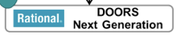




Build a Delivery Pipeline Leveraging Tools-As-a-Service
Developers launch test from their workspace
Executes 10000s of Junits & security scans
Rapid install and smoke Tests
Functional and systems tests on Golden Topologies
Build
Test (continuous)
Interactive Testing
Production
Develop
BVT
System Test
Unit Test
Function Test
Usability Test
Jazz.net
Production-Like Environment
Production-Like Environment
IBM Bluemix DevOps Services
Performance Test
Integration Test
Security Pen Testing
Continuous Integration and Test
Virtualized Infrastructure Golden Topologies Deployments
14 different pipelines running concurrently for new dev and multiple service streams
Automated quality gates with team based dashboard focused on single view of quality
>210,000 jazz.net community members,
>600K page views per month
Notes:
27

Slide 28
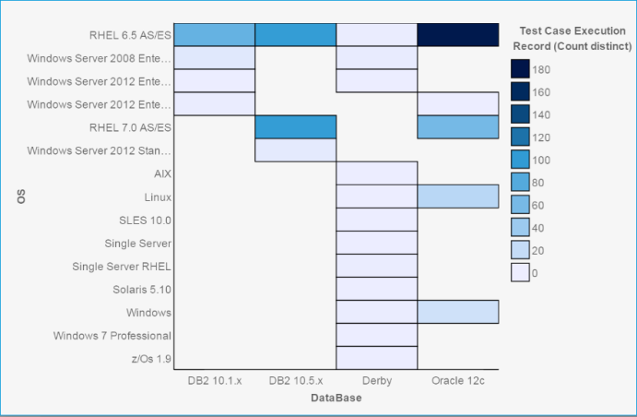
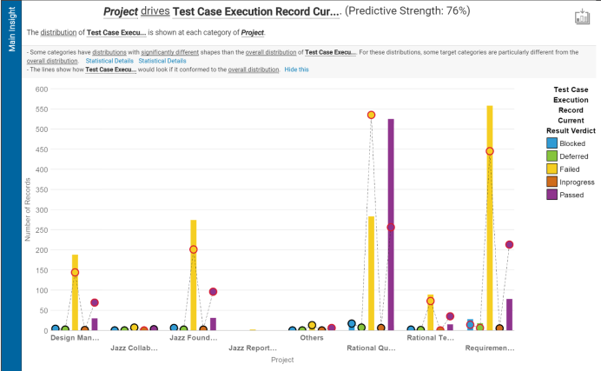
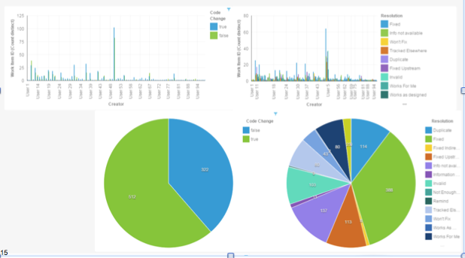
Cognitive Analysis applied to our DevOps Journey
We used IBM Watson to explore, predict and create dashboards from our sprint test data:
Examined 562 test cases and 1106 work items/defects
Showed relative test case coverage by OS/DB/platform and showed areas to where we should shift focus
Showed high defect correlation between certain OS/DB combinations and product capability identifying problematic code for increased peer reviews and refactoring
Provided insight into invalid defects highlighting areas for continuous improvement
Experience report available:
https://jazz.net/library/article/1529
“We validated test coverage, discovered data trends which helped us improve training and reduce invalid defects by more than 50%.”
- Brian Lang, Scrum Master, IBM
Notes:
We have been capturing data as a part of DevOps environment and now we are experimenting with Watson Services to help us gain insights not previously possible. We learned a significant amount about the patterns of data which have driven us to make continued improvements in our training, documentation etc.

Slide 29
What am I most excited about for the next year?
Cognitive computing and data analytics
Tons of data captured from DevOps processes
Skeptic turned to now intrigued about the possibilities ☺
Continued change at IBM
Agile and DevOps practices being adopted across IBM
Culture: New leadership competencies/recognition focus on driving change
Process: Design Thinking, Breaking the inertia
Technology: Embrace open and market experimentation to learn

Slide 30
Announcing
IBM Bluemix Garage Method
Think Conceptualization, refinement, and prioritization of capabilities
Learn Continuously learn based on outcome from experiments
Code Generation, enhancement, optimization and testing of features
Combining industry best practices for Design Thinking, Lean Startup, Agile Development, DevOps, and Cloud to build and deliver innovative solutions.
Culture Foundational
values and principles
Manage Ongoing monitoring, support, and recovery of offerings
Deliver Automated production and delivery of offerings
Run Services, options, and capabilities required to run in the Cloud
Visit the IBM booth, or:
https://www.ibm.com/devops/method
Notes:
IBM’s practical method combines the best of open communities, Design Thinking, Lean Startup, with an agile DevOps methodology. An open and repeatable method with best practices, tool chains and a thriving ecosystem. Provides:
Hardened method-ware, delivered as digital experience and practice library of work-product assets.
Accelerators to speed adoption, combining tool chains and methods.
Shared learning (videos, case studies, blogs) of IBM transformation; extends to clients, phase 2.
Open community forum to engage, comment, progress and extend methodology.

Slide 31

Takeaways:
Metrics driven by business objectives will lead to success.
Look for quick wins to gain momentum then scale out.
Delivery pipeline is the heartbeat of the team. Take care of it like your own ☺
Foster champions for change at all levels of the organization – they are essential to make it happen.
You won’t get it right the first time: create a culture of continuous improvement.

Slide 32

Here is what we need help with
Automated impact analysis
Automated dependency analysis
“Release when ready”
Tips around shifting to cloud
Stay in touch: @dibbeedwards, dibbed@us.ibm.com, @michaelbueche

Slide 33
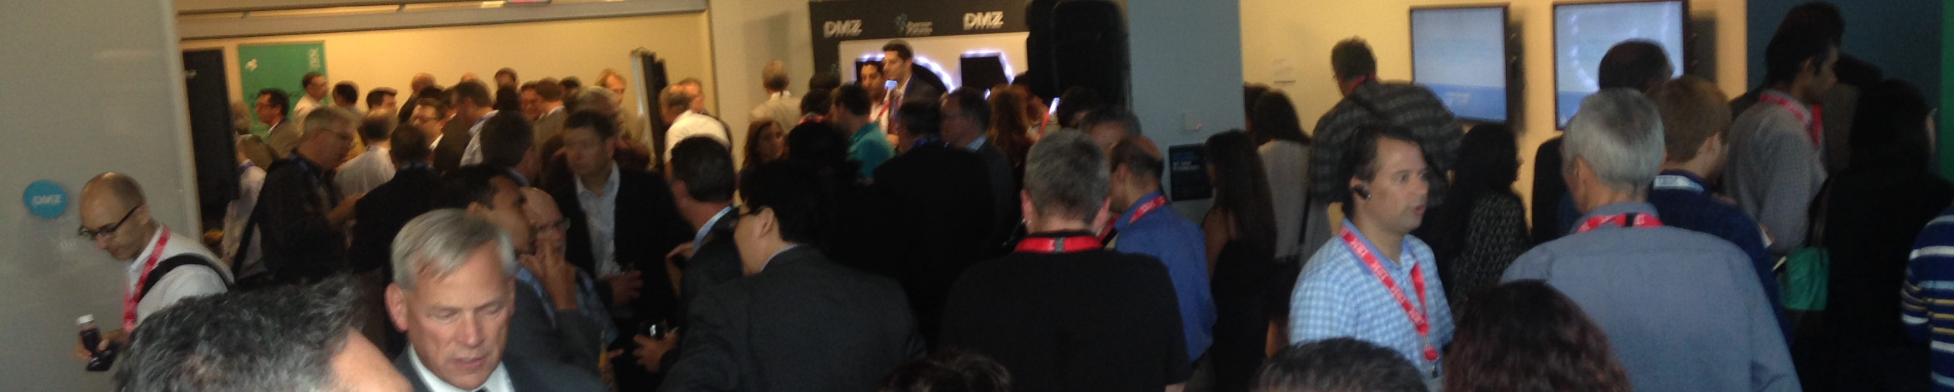
Join us tonight – for a Night at the Garage!
Monday, October 19 7:00 – 9:00 pm PT Bluemix Garage at Galvanize 44 Tehama Street San Francisco, CA 94105
Beer & wine, local cuisine, live rooftop music!
Plus, great DevOps discussion & demo stations
Trolleys depart at 6:45 and 7:00 pm from the Market Street entrance of the Hyatt Regency (and return until 9:30 pm)

